Slide 1

II-I CSE(autonomous)

Slide 2
Units:
Basic Structure of Computers
Register Transfer Language and Microoperations
Control Unit Design, Arithmetic & Logic Operations
8086 Microprocessors architecture
ALP using 8086 Microprocessors
8255-PPI

Slide 3
Books:
“Computer System Architecture” by Morris Mano.
“ Computer Organization and Architecture” by William Stallings.
“Computer Organization” by Carl Hamacher

Slide 4
Basic Structure of Computers
Unit-1

Slide 5
Contents:
Computer Types (7)
Functional Unit (10)
Basic OPERATIONAL concepts (20)
Bus structures (32)
Software (36)
Performance (40)
Multiprocessors and Multi computers (57)
Data Representation (61)
Fixed Point Representation (67)
Floating Point Representation (70)

Slide 6
Introduction:
Computer Organization
It describes the function and design of the various units of digital computers that store and process information.
It also deals with the units of computer that receive information from external sources and send computed results to external destinations.

Slide 7
1. Computer types
Digital computer :
It is a fast electronic calculating machine that accepts digitized input information, processes it according to a list of internally stored instructions, and produces the resulting output information.
(1) Personal computer :
It is the most common form of desktop computers.
Desk top computers have processing and storage units, visual display and audio output units, and a keyboard that can all be located easily on a home or office desk. The storage media include hard disks, CD-ROMs and diskettes.
Portable notebook computers are a compact version of the personal computers with all of these components packaged into single unit the size of a thin briefcase

Slide 8
Computer types (contd.,)
(2) Workstations:
Work stations with high resolution graphics input/output capability, although still retaining the dimensions of desktop computers, have significantly more computational power than personal computers.
Workstations are often used in engineering applications, especially for interactive design works.
(3) Enterprise systems or mainframes:
These are used for business data processing in medium to large corporations that require much more computing power and storage capacity than workstations can provide.

Slide 9
Computer types (contd.,)
4) Servers :
Servers contain sizable database storage units and are capable of handling large volumes of requests to access the data.
The Internet and its associated servers have become a dominant world wide source of all types of information.
5) Super Computers :
Super Computers are used for the large scale numerical calculations required in applications such as weather forecasting, aircraft design and simulation.

Slide 10
2. Functional units
A computer consists of five functionally independent main parts:
Input unit
Memory unit
Arithmetic and logic unit (ALU)
Output unit
Control unit

Slide 11
The structure of a digital computer is shown below
I / O
EQUIP-
MENT
MAIN
MEMORY
ALU
CONTROL
UNIT

Slide 12
Operation of a computer
The computer accepts information in the form of programs and data through an input unit and stores it in the memory.
Information stored in the memory is fetched, under program control, into an arithmetic and logic unit, where it is processed.
Processed information leaves through an output.
All activities inside the machine are directed by the control unit.

Slide 13
Input unit
Computers accept coded information through input units.
The most well known input device is key board.
Whenever a key is pressed, the corresponding letter or digit is automatically translated into its corresponding binary code and transmitted over a cable to either the memory or the processor.

Slide 14
Memory unit
The function of the memory is to store programs and data.
There are two classes of storage, called primary and secondary.
Primary storage is a fast memory that operates at electronic speeds.
Programs must stay in memory while they are being executed.
The memory contains a large number of semiconductor storage cells, each capable of storing one bit of information.
Random access memory: Memory in which any location can be reached in a short and fixed amount of time after specifying its address is called random access memory (RAM).

Slide 15
Memory unit (Contd.,)
The time required to access one word is called the memory access time.
Cache memory: The small, fast, RAM units are called caches.
They are tightly coupled with the processor and are often contained on the same integrated circuit chip to achieve high performance.
Main memory: The largest and slowest unit is referred to as the main memory.

Slide 16
Memory unit (Contd.,)
Secondary storage:
Although primary storage is essential, it tends to be expensive.
Thus additional, cheaper, secondary storage is used when large amounts of data and many programs have to be stored, particularly for information that is accessed infrequently.
A wide selection of secondary storage devices is available, including magnetic disks, tapes and optical disks (CD-ROMs)

Slide 17
Arithmetic and logic unit (ALU)
Most computer operations are executed in the arithmetic and logic unit (ALU) of the processor.
For example, Suppose two numbers are to be added.
They are brought into the processor, and the actual addition is carried out by the ALU.
The sum may then be stored in the memory or retained in the processor for immediate use.
When operands are brought into the processor, they are stored in high-speed storage elements called registers.

Slide 18
Output unit
The output unit is the counterpart of input unit.
Its function is to send processed results to the outside world.
The most familiar example of such a device is a printer.
Some units, such as graphic displays, provide an input function and an output function. The dual role of such units is the reason for using the single name I/O unit in many cases.

Slide 19
Control unit
The memory, arithmetic and logic, and I/O units store and process information and perform input and output operations.
The operations of these units are coordinated by control unit.
The control unit is effectively the nerve center that sends control signals to other units and senses their states.

Slide 20
3. Basic operational concepts
To perform a given task, an appropriate program consisting of a list of instructions is stored in the memory.
Individual instructions are brought from the memory into the processor, which execute the specified operations.
Data to be used as operands are also stored in the memory

Slide 21
Connections between the processor and the memory
Memory
Processor
MAR
MDR
Control
R₀
PC
R₁
IR
.
.
.
ALU
R_{n-1}
n general purpose
registers

Slide 22
Instruction register (IR)
The instruction register holds the instruction that is currently being executed.
Its output is available to the control circuits, which generate the timing signals that control the various processing elements involved in executing the instruction

Slide 23
Program Counter (PC)
The program counter is another specialized register.
It keeps track of the execution of a program.
It contains the memory address of the next instruction to be fetched and executed.
During the execution of an instruction, the contents of the PC are updated to correspond to the address of the next instruction to be executed.
It is customary to say that PC points to the next instruction that is to be fetched from the memory.

Slide 24
Memory address register (MAR) &
Memory data register (MDR)
These two registers facilitate communication with the memory.
The MAR holds the address of the location to be accessed.
The MDR contains the data to be written into or read out of the addressed location.

Slide 25
Operating steps for Program execution
Programs are stored in the memory through the input unit.
Execution of the program starts when the PC is set to point to the first instruction of the program.
The contents of the PC are transferred to the MAR and a Read control signal is sent to the memory.
After the time required to access the memory elapses, the addressed word (in this case, the first instruction of the program) is read out of the memory and loaded into the MDR.

Slide 26
Operating steps for Program execution (Contd.,)
Next, the contents of the MDR are transferred to the IR .
At this point, the instruction is ready to be decoded and executed.
If the instruction involves an operation to be performed by the ALU, it is necessary to obtain the required operands.
If an operand resides in memory ( it could also be in a general-purpose register in the processor), it has to be fetched by sending its address to the MAR and initiating a Read cycle.

Slide 27
Operating steps for Program execution (Contd.,)
When the operand has been read from the memory into the MDR, it is transferred from the MDR to the ALU.
After one or more operands are fetched in this way, the ALU can perform the desired operation.
If the result of the operation is to be stored in the memory, then the result is sent to the MDR.
The address of the location where the result is to be stored is sent to the MAR, and a write cycle is initiated.

Slide 28
Operating steps for Program execution (Contd.,)
At some point during the execution of the current instruction, the contents of the PC are incremented so that the PC points to the next instruction to be executed.
Thus, as soon as the execution of the current instruction is completed, a new instruction fetch may be started.
In addition to transferring data between the memory and the processor, the computer accepts data from input devices and sends data to output devices. Thus, some machine instructions with the ability to handle I/O transfers are provided.

Slide 29
Interrupt service routine
Normal execution of a programs may be preempted if some device requires urgent servicing.
For example, a monitoring device in a computer-controlled industrial process may detect a dangerous condition.
In order to deal with the situation immediately, the normal execution of the current program must be interrupted.
To do this, the device raises an interrupt signal.
An interrupt is a request from an I/O device for service by the processor.
The processor provides the requested service by executing an appropriate interrupt-service routine.

Slide 30
Interrupt service routine (contd.,)
Because such diversions may alter the internal state of the processor, its state must be saved in the memory locations before servicing the interrupt.
Normally, the contents of the PC, the general registers, and some control information are stored in memory.
When the interrupt service routine is completed, the state of the processor is restored so that the interrupted program may continue.

Slide 31
4. Bus structures
A group of lines(wires) that serves as a connecting path for several devices of a computer is called a bus.
In addition to the lines that carry the data, the bus must have lines for address and control purposes.
The simplest way to interconnect functional units is to use a single bus, as shown below.
input
output
memory
processor

Slide 32
Bus structures (contd.,)
All units are connected to this bus. Because the bus can be used for only one transfer at a time, only two units can actively use the bus at any given time.
Bus control lines are used to arbitrate multiple requests for use of the bus.
The main virtue of the single-bus structure is its low cost and its flexibility for attaching peripheral devices.
Systems that contain multiple buses achieve more concurrency in operations by allowing two or more transfers to be carried out at the same time. This leads to better performance but at an increased cost.

Slide 33
How timing differences are smoothed out among processors, memories and I/O devices?.
The devices connected to a bus vary widely in their speed of operation.
Electro mechanical devices such as key board and printers are relatively slow.
Others like magnetic or optical disks, are considerably faster.
Memory and processor units operate at electronic speeds.
A common approach to smooth out the timing differences is to include buffer registers with the devices to hold the information during transfers.
They prevent a high speed processor from being locked to a slow I/O device during a sequence of data transfers.

Slide 34
Contd.,
This allows the processor to switch rapidly from one device to another, interweaving its process activity with data transfers involving several I/O devices.
Thus, buffer registers smooth out timing differences among processors, memories and I/O devices.

Slide 35
5. Software
The role of system software in a computer.
System software is responsible for the coordination of all activities in a computing system.
System software is a collection of programs that are executed as needed to perform functions such as
1) Receiving and interpreting user commands.
2) Entering and editing application programs and storing them as files in secondary storage devices.
3) Managing the storage and retrieval of files in secondary storage devices.

Slide 36
Contd.,
4) Running standard application programs such as word processors, spread sheets, or games, with data supplied by the user.
5) Controlling I/O units to receive input information and produce output results.
6) Translating programs from high level language to low level language.
7) Linking and running user-written application programs with existing standard library routines, such as numerical computation packages.

Slide 37
Various components of system software.
Compiler : A system software program which translates the high-level language program into a suitable machine language program.
Text editor: Another important system program that all programmers use is a text editor.
It is used for entering and editing application programs.
The user of this program interactively execute commands that allow statements of a source program entered at a keyboard to be accumulated in a file.

Slide 38
Contd.,
Operating system (OS)
It is a key system software component.
This is a large program, or actually a collection of routines , that is used to control the sharing of and interaction among various computer units as they execute application programs.
The OS routines perform the tasks required to assign computer resources to individual application programs.
These tasks include assigning memory to program and data files, moving data between memory and disk units, and handling I/O operations.

Slide 39
6. Performance
Various parameters for improving the performance of a computer.
The most important measure of the performance of a computer is how quickly it can execute a programs.
The speed with which a computer executes programs is affected by the design of its hardware and its machine language instructions.
Elapsed time: The total time required to execute a program .
This elapsed time is a measure of the performance of the entire computer system.
It is affected by the speed of the processor, the disk and the printer.

Slide 40
Contd.,
Processor time:
Here we have to consider only those periods of the elapsed time, during which the processor is active.
The sum of these periods is called processor time.
The processor time depends on the hardware involved in the execution of individual machine instructions.
Cache memory:
The processor and a relatively small cache memory can be fabricated on a single IC chip.
The internal speed of performing the basic steps of instruction processing on such chips is very high and considerably faster than the speed at which instructions and data can be fetched from the main memory.

Slide 41
Contd.,
A program will be executed faster if the movement of instructions and data between the main memory and processor is minimized, which is achieved by using the cache.
Main
memory
Processor
Cache
memory
Bus

Slide 42
Processor clock
Processor circuits are controlled by a timing signal called a clock .
The clock defines regular time intervals, called clock cycles.
To execute a machine instruction, the processor divides the action to be performed into a sequence of basic steps, such that each step can be completed in one clock cycle.
The length P of one clock cycle is an important parameter that affects processor performance.
Its inverse is the clock rate, R = 1/P , which is measured in cycles per second .
If the clock rate is 500 million cycles per second, then the corresponding clock period is 2 nanoseconds.

Slide 43
Basic performance equation
Let ‘T’ be the processor time required to execute a program that has been prepared in some high level language.
Assume that the complete execution of the program requires the execution of ‘N’ machine language instructions.
Suppose that the average number of basic steps needed to execute one machine instruction is ‘S’.
If the clock rate is ‘R’ cycles per second, the program execution time is given by
T = N . S
R
This is often referred to as the basic performance equation.

Slide 44
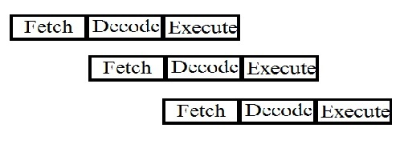
Pipelining and Super scalar operation
A substantial improvement in performance can be achieved by overlapping the execution of successive instructions, using a technique called pipelining .

Slide 45
Super scalar operation
A higher degree of concurrency can be achieved if multiple instruction pipelines are implemented in the processor.
This means that multiple function units are used, creating parallel paths through which different instructions can be executed in parallel.
With such an arrangement, it becomes possible to start the execution of several instructions in every clock cycle.
This mode of execution is called Super scalar operation.

Slide 46
Instruction set : CISC and RISC
The terms CISC and RISC refer to design principles and techniques.
RISC : Reduced instruction set computers
Simple instructions require a small number of basic steps to execute.
For a processor that has only simple instructions, a large number of instructions may be needed to perform a given programming task.
This could lead to a large value of N and a small value for S.
It is much easier to implement efficient pipelining in processors with simple instruction sets.

Slide 47
Instruction set : CISC and RISC (contd.,)
CISC: Complex instruction set computers.
Complex instructions involve a large number of steps.
If individual instructions perform more complex operations, fewer instructions will be needed, leading to a lower value of N and a larger value of S.
Complex instructions combined with pipelining would achieve good performance.

Slide 48
Compiler
A compiler translates a high-level language program into a sequence of machine instructions.
To reduce N, we need to have a suitable machine instruction set and a compiler that makes good use of it.
An optimizing compiler takes advantage of various features of the target processor to reduce the product N.S .
The compiler may rearrange program instructions to achieve better performance.

Slide 49
7. Multiprocessors and Multi-computers
Large computer systems may contain a number of processor units, in which case they are called multiprocessor systems.
These systems either execute a number of different application tasks in parallel, or they execute subtasks of a single large task in parallel.
All processors usually have access to all of the memory in such systems, and the term shared-memory multiprocessor systems is often used to make this clear.

Slide 50
Multiprocessors (contd.,)
The high performance of these systems comes with much increased complexity and cost.
In addition to multiple processors and memory units, cost is increased because of the need for more complex interconnection networks.

Slide 51
Multi-Computers:
In contrast to multiprocessor systems, it is possible to use an interconnected group of complete computers to achieve high total computational power.
The computers normally have access only to their own memory units. When the tasks they are executing need to communicate data, they do so by exchanging messages over a communication network.
This property distinguishes them from shared-memory multiprocessors, leading to the name message-passing multi- computers.

Slide 52
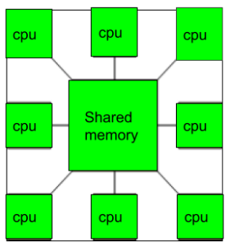
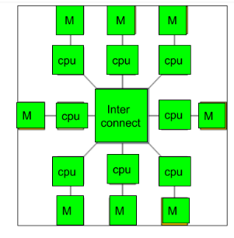
Difference between Multiprocessors and Multi-computers
Multiprocessors | Multicomputers
A System with two or more processors that allows simultaneous processing of programs | A set of processors connected by the communication network that works jointly to solve a computational problem
Easier to process | Less easy to program
Common Operating System | Different Operating Systems
Tightly coupled (Sharing the Same Memory) | Loosly Coupled ( Different memory for different computers) Message passing Multicomputer
Supports parallel computing | Supports Distributed computing

Slide 53
8. Data Representation
Data Types
  Binary information is stored in memory or processor registers
  Registers contain either data or control information
    Data are numbers and other binary-coded information
    Control information is a bit or a group of bits used to specify the sequence of command signals
  Data types found in the registers of digital computers
    Numbers used in arithmetic computations
    Letters of the alphabet used in data processing
    Other discrete symbols used for specific purpose
  Number Systems
    Base or Radix r system : uses distinct symbols for r digits
    Most common number system :Decimal, Binary, Octal, Hexadecimal
    Positional-value(weight) System : r² r ¹r⁰.r⁻¹ r⁻² r⁻³
      Multiply each digit by an integer power of r and then form he sum of all weighted digits

Slide 54
  Decimal System/Base-10 System
    Composed of 10 symbols or numerals(0, 1, 2, 3, 4, 5, 6, 7, 8, 9, 0)
  Binary System/Base-2 System
    Composed of 10 symbols or numerals(0, 1)
    Bit = Binary digit
  Hexadecimal System/Base-16 System
    Composed of 16 symbols or numerals(0, 1, 2, 3, 4, 5, 6, 7, 8, 9, A, B, C, D, E, F)
  Binary-to-Decimal Conversions
1011.101₂ = (1 x 2³) + (0 x 2²)+ (1 x 2¹) + (1 x 2º) + (1 x 2⁻¹) + (0 x 2⁻²) + (1 x 2⁻³)
= 8₁₀+ 0 + 2₁₀ + 1₁₀ + 0.5₁₀ + 0 + 0.125₁₀
= 11.625₁₀
  Decimal-to-Binary Conversions
    37 / 2 = 18 remainder 1 (binary number will end with 1) : LSB
18 / 2 = 9 remainder 0
9 / 2 = 4 remainder 1
4 / 2 = 2 remainder 0
2 / 2 = 1 remainder 0
1 / 2 = 0 remainder 1 (binary number will start with 1) : MSB
  Read the result upward to give an answer of 37₁₀ = 100101₂
  0.375 x 2 = 0.750 integer 0 MSB
    0.750 x 2 = 1.500 integer 1 .
    0.500 x 2 = 1.000 integer 1 LSB
  Read the result downward .375₁₀ = .011₂

Slide 55
  Hex-to-Decimal Conversion
2AF₁₆ = (2 x 16²) + (10 x 16¹) + (15 x 16º)
= 512₁₀ + 160₁₀ + 15₁₀
= 687₁₀
  Decimal-to-Hex Conversion
423₁₀ / 16 = 26 remainder 7 (Hex number will end with 7) : LSB
26₁₀ / 16 = 1 remainder 10
1₁₀ / 16 = 0 remainder 1 (Hex number will start with 1) : MSB
  Read the result upward to give an answer of 423₁₀ = 1A7₁₆
  Hex-to-Binary Conversion
9F2₁₆ = 9 F 2
= 1001 1111 0010
= 100111110010₂
Hex Binary Decimal
0 0000 0
1 0001 1
2 0010 2
3 0011 3
4 0100 4
5 0101 5
6 0110 6
7 0111 7
8 1000 8
9 1001 9
A 1010 10
B 1011 11
C 1100 12
D 1101 13
E 1110 14
F 1111 15
  Binary-to-Hex Conversion
1 1 1 0 1 0 0 1 1 0₂ = 0 0 1 1 1 0 1 0 0 1 1 0
3 A 6
= 3A6₁₆

Slide 56
Complements
  Complements are used in digital computers for simplifying the subtraction operation and for logical manipulation
  There are two types of complements for base r system
    1) r’s complement 2) (r-1)’s complement
      Binary number : 2’s or 1’s complement
      Decimal number : 10’s or 9’s complement
  (r-1)’s Complement
    (r-1)’s Complement of N = (r^{n}-1)-N
      9’s complement of N=546700
      (10⁶-1)-546700= (1000000-1)-546700= 999999-546700
      = 453299
      1’s complement of N=101101
      (2⁶-1)-101101= (1000000-1)-101101= 111111-101101
      = 010010
  r’s Complement
    r’s Complement of N = r^{n}-N
      10’s complement of 2389= 7610+1= 7611
      2’s complement of 1101100= 0010011+1= 0010100
N : given number
r : base
n : digit number
546700(N) + 453299(9’s com)
=999999
101101(N) + 010010(1’s com)
=111111
* r’s Complement
(r-1)’s Complement +1 =(r^{n}-1)-N+1= r^{n}-N

Slide 57
  Subtraction of Unsigned Numbers
    1) M + (r^{n}-N)
    2) M ≥ N : Discard end carry, Result = M-N
    3) M < N : No end carry, Result = - r’s complement of (N-M)
      Decimal Example)
      72532(M) - 13250(N) = 59282
      72532
      + 86750 (10’s complement of 13250)
      1 59282
      Result = 59282
      Binary Example)
      1010100(X) - 1000011(Y) = 0010001
      1010100
      + 0111101 (2’s complement of 1000011)
      1 0010001
      Result = 0010001
(M-N), N≠0
M ≥ N
M < N
      13250(M) - 72532(N) = -59282
      13250
      + 27468 (10’s complement of 72532)
      0 40718
      Result = -(10’s complement of 40718)
      = -(59281+1) = -59282
Discard End Cary
No End Carry
X < Y
X ≥ Y
      1000011(X) - 1010100(Y) = -0010001
      1000011
      + 0101100 (2’s complement of 1010100)
      0 1101111
      Result = -(2’s complement of 1101111)
      = -(0010000+1) = -0010001

Slide 58
*Numeric Data
1) Fixed Point
2) Floating Point
9. Fixed-Point Representation
  Computers must represent everything with 1’s and 0’s, including the sign of a number and fixed/floating point number
  Binary/Decimal Point
    The position of the binary/decimal point is needed to represent fractions, integers, or mixed integer-fraction number
  Two ways of specifying the position of the binary point in a register
    1) Fixed Point : the binary point is always fixed in one position
      A binary point in the extreme left of the register(Fraction : 0.xxxxx)
      A binary point in the extreme right of the register(Integer : xxxxx.0)
        The binary point is not actually present, but the number stored in the register is treated as a fraction or as an integer
    2) Floating Point : the second register is used to designate the
    position of the binary point in the first register.
  Integer Representation
    Signed-magnitude representation
    Signed-1’s complement representation
    Signed-2’s complement representation
* 32.25
1) 0.25, 2) 32.0, 3) 32.25
* MSB for Sign
“0” is plus +
“1” is minus -
+14 -14
0 0001110 1 0001110
0 0001110 1 1110001
0 0001110 1 1110010
Most Common

Slide 59
  Arithmetic Addition
    Addition Rules of Ordinary Arithmetic
      The signs are same : sign= common sign, result= add
      The signs are different : sign= larger sign, result= larger-smaller
    Addition Rules of the signed 2’s complement
      Add the two numbers including their sign bits
      Discard any carry out of the sign bit position
  Arithmetic Subtraction
    Subtraction is changed to an Addition
      (± A) - (+ B) = (± A) + (- B)
      (± A) - ( - B) = (± A) + (+ B)
(-12) + (-13) = -25
(+12) + (+13) = +25
(+25) + (-37)
= 37 - 25 = -12
*Addition Example
+ 6 00000110 - 6 11111010
+ 13 00001101 + 13 00001101
+ 19 00010011 + 7 00000111
+ 6 00000110 - 6 11111010
- 13 11110011 - 13 11110011
- 7 11111001 - 19 11101101
* Subtraction Example (- 6) - ( - 13) = +7
11111010 - 11110011 = 11111010 + 2’s comp of 11110011
= 11111010 + 00001101
= 1 00000111 = +7

Slide 60
* Decimal + 6132.789
Fraction Exponent
+0.6132789 +4
10. Floating-Point Representation
  The floating-point representation of a number has two parts
    1) Mantissa : signed, fixed-point number
    2) Exponent : position of binary(decimal) point
  Scientific notation : m x r^{e} (+0.6132789 x 10⁺⁴)
    m : mantissa, r : radix, e : exponent
  Example : m x 2e = +(.1001110)₂ x 2⁺⁴
  Normalization
    Most significant digit of mantissa is nonzero
Fraction Exponent
01001110 000100

Slide 61
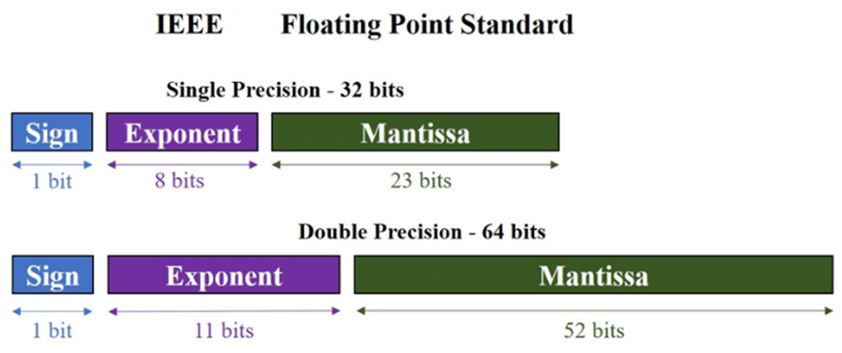

Slide 62
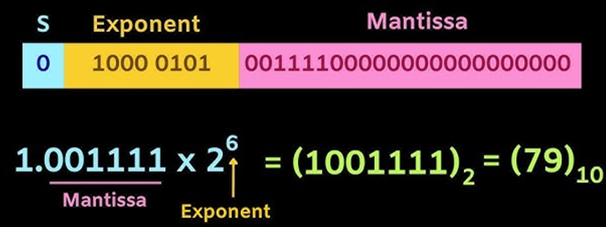
Single Precision Floating Point Representation

Slide 63
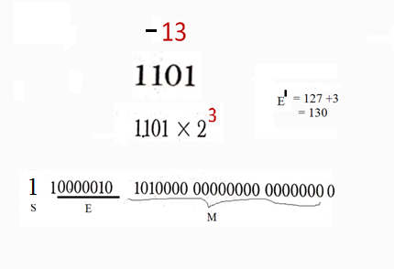

Slide 64
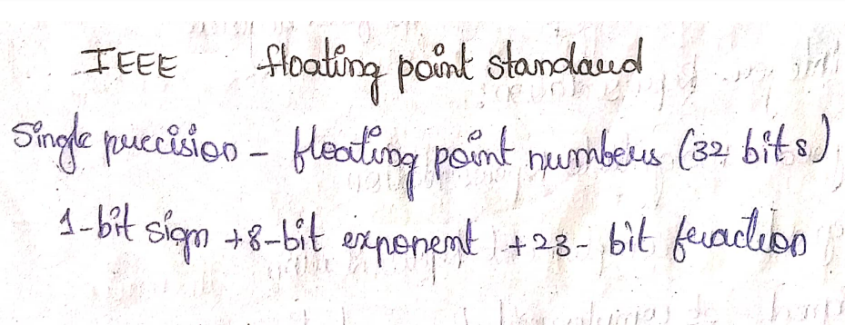
Example : (1259.125)10

Slide 65
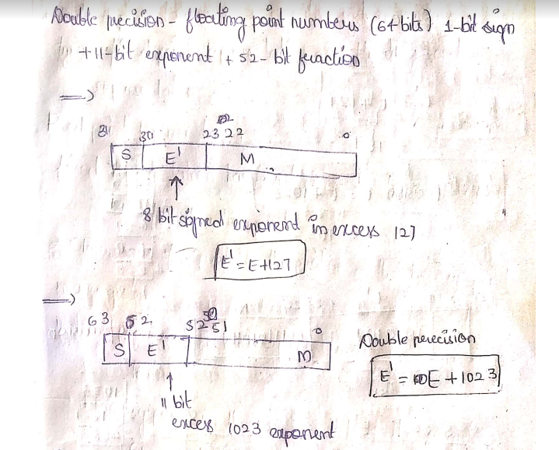

Slide 66
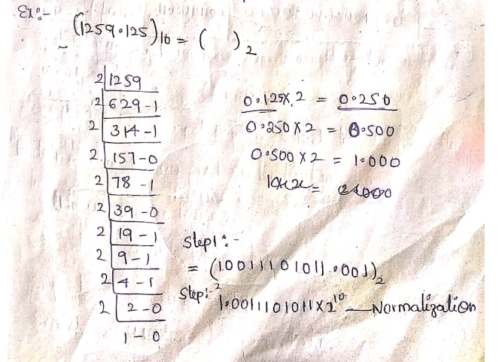

Slide 67
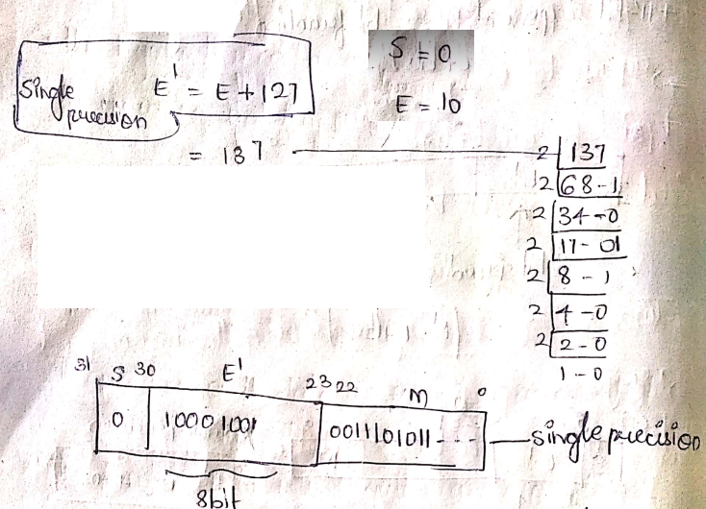

Slide 68
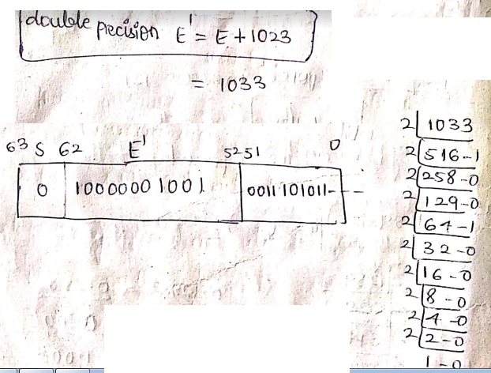

Slide 69


Slide 70
UNIT-1 (priority wise)
1) Perform arithmetic operations (+65)+(-14),(-65)-(-24).
2) Distinguish multiprocessor and multicomputer.
3) Explain basic operations of a computer.
4) Explain performance of a computer.
5) Explain about software.
6) Define bus explain single bus structure.
7) Explain about basic computer.
8) Mention types of computers.

